Slide 1
CCENT Study Guide
Chapter 13
Network Address Translation

Slide 2
Chapter 13 Objectives
The CCENT Topics Covered in this chapter include:
4.0 Infrastructure Services
4.7 Configure, verify, and troubleshoot inside source NAT.
4.7.a Static
4.7.b Pool
4.7.c PAT

Slide 3
When Do We Use NAT?
Network Address Translation (NAT) is similar to Classless Inter-Domain Routing (CIDR) in that the original intention for NAT was to slow the depletion of available IP address space by allowing multiple private IP addresses to be represented by a much smaller number of public IP addresses.
Here’s a list of situations when NAT can be especially helpful:
When you need to connect to the Internet and your hosts don’t have globally unique IP addresses
When you’ve changed to a new ISP that requires you to renumber your network
When you need to merge two intranets with duplicate addresses

Slide 4
Figure 13.1: Where to configure NAT
You typically use NAT on a border router. For example, in Figure 13.1, NAT is used on the Corporate router connected to the Internet.

Slide 5
Types of NAT
Static NAT
This type of NAT is designed to allow one-to-one mapping between local and global addresses. Keep in mind that the static version requires you to have one real Internet IP address for every host on your network.
Dynamic NAT
This version gives you the ability to map an unregistered IP address to a registered IP address from out of a pool of registered IP addresses. You don’t have to statically configure your router to map each inside address to an individual outside address as you would using static NAT, but you do have to have enough real, bona-fide IP addresses for everyone who’s going to be sending packets to and receiving them from the Internet at the same time.
Overloading
This is the most popular type of NAT configuration. Understand that overloading really is a form of dynamic NAT that maps multiple unregistered IP addresses to a single registered IP address (many-to-one) by using different source ports. Now, why is this so special? Well, because it’s also known as Port Address Translation (PAT), which is also commonly referred to as NAT Overload. Using PAT allows you to permit thousands of users to connect to the Internet

Slide 6
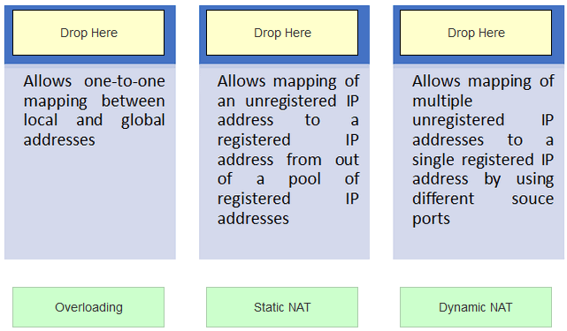
In-class Practice

Slide 7
NAT Terms
Names | Meaning
Inside local | Source host inside address before translation—typically an RFC 1918 address
Outside local | Address from which source host is known on the Internet. This is usually the address of the router connected to ISP—the actual Internet address.
Inside global | Source host address used after translation to get onto Internet. This is also the actual Internet address.
Outside global | Address of outside destination host and, again, the real Internet address

Slide 8
Figure 13.2: Basic NAT translation
In this figure, we can see host 10.1.1.1 sending an Internet-bound packet to the border router configured with NAT. The router identifies the source IP address as an inside local IP address destined for an outside network, translates the source IP address in the packet, and documents the translation in the NAT table.
The packet is sent to the outside interface with the new translated source address. The external host returns the packet to the destination host, and the NAT router translates the inside global IP address back to the inside local IP address using the NAT table. This is as simple as it gets!

Slide 9
Figure 13.3: NAT overloading example (PAT)
With PAT, all inside hosts get translated to one single IP address, hence the term overloading. Again, the reason we’ve just run out of available global IP addresses on the Internet is because of overloading (PAT).

Slide 10
Static NAT Configuration
Let’s take a look at a simple example of a basic static NAT configuration:
ip nat inside source static 10.1.1.1 170.46.2.2
!
interface Ethernet0
ip address 10.1.1.10 255.255.255.0
ip nat inside
!
interface Serial0
ip address 170.46.2.1 255.255.255.0
ip nat outside
!
In the preceding router output, the ip nat inside source command identifies which IP addresses will be translated. In this configuration example, the ip nat inside source command configures a static translation between the inside local IP address 10.1.1.1 to the inside global IP address 170.46.2.2.

Slide 11
Dynamic NAT Configuration
Basically, dynamic NAT really means we have a pool of addresses that we’ll use to provide real IP addresses to a group of users on the inside. Because we don’t use port numbers, we must have real IP addresses for every user who’s trying to get outside the local network simultaneously.
Here is a sample output of a dynamic NAT configuration:
ip nat pool todd 170.168.2.3 170.168.2.254
netmask 255.255.255.0
ip nat inside source list 1 pool todd
!
interface Ethernet0
ip address 10.1.1.10 255.255.255.0
ip nat inside
!
interface Serial0
ip address 170.168.2.1 255.255.255.0
ip nat outside
!
access-list 1 permit 10.1.1.0 0.0.0.255
!

Slide 12
PAT (Overloading) Configuration
This is the typical form of NAT that we would use today. It’s actually now rare to use static or dynamic NAT unless it is for something like statically mapping a server, for example.
Here is a sample output of a PAT configuration:
ip nat pool globalnet 170.168.2.1 170.168.2.1 netmask 255.255.255.0
ip nat inside source list 1 pool globalnet overload
!
interface Ethernet0/0
ip address 10.1.1.10 255.255.255.0
ip nat inside
!
interface Serial0/0
ip address 170.168.2.1 255.255.255.0
ip nat outside
!
access-list 1 permit 10.1.1.0 0.0.0.255

Slide 13
Simple Verification of NAT
See basic IP address translation info
#show ip nat translation
Verify your NAT configuration
#debug ip nat

Slide 14
Figure 13.4: NAT example
To start, look at Figure 13.4 and ask yourself two things: Where would you implement NAT in this design, and what type of NAT would you configure?
In Figure 13.4, the NAT configuration would be placed on the corporate router, just as I demonstrated with Figure 13.1, and the configuration would be dynamic NAT with overload (PAT).

Slide 15
Figure 13.5: Another NAT example
Figure 13-5 shows a border router that needs to be configured with NAT and allow the use of six public IP addresses to the inside locals, 192.1.2.109 through 192.1.2.114. However, on the inside network, you have 62 hosts that use the private addresses of 192.168.10.65 through 192.168.10.126.
Actually, two different answers would both work here, but the following would be my first choice based on the exam objectives:
ip nat pool Todd 192.1.2.109 192.1.2.109 netmask 255.255.255.248
access-list 1 permit 192.168.10.64 0.0.0.63
ip nat inside source list 1 pool Todd overload

Slide 16
Written Labs and Review Questions
Read through the Exam Essentials section together in class.
Open your books and go through all the written labs and the review questions.
Review the answers in class.
16

